Slide 1
This slide is hidden.
Insert the starting slides after this slide

Slide 2



Slide 3

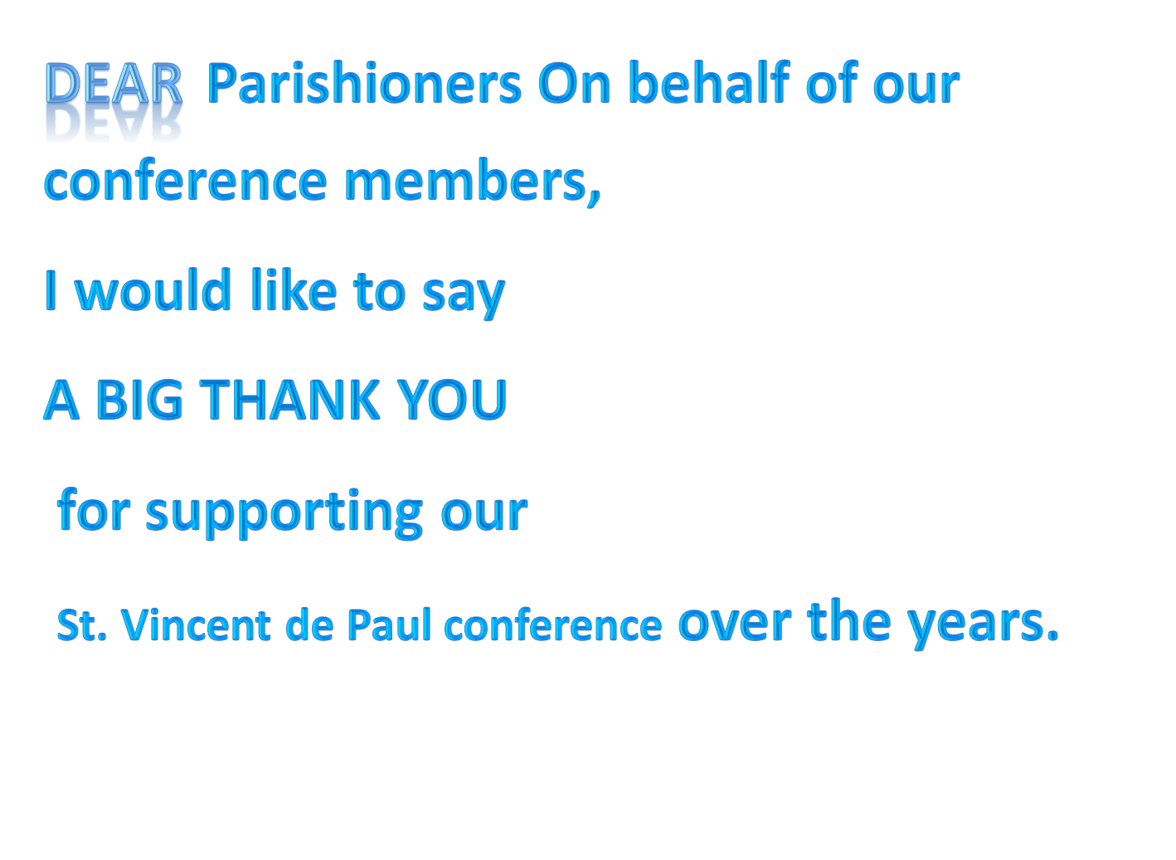

Slide 4
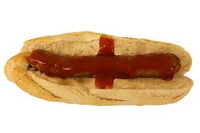
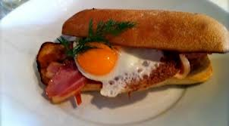
Our winter appeal will be is today
15th June.
There will be a BBQ of Bacon, Eggs & sausages, for sale after the
8AM and the 9.30AM Masses
all monies raised will go to our winter appeal

Slide 5


Slide 6

Welcome to St Michael’s
Trinity Sunday
You have entered a
SACRED SPACE
– a SACRED TIME...
Please ensure all
mobile phones
are switched off.
Please be respectfully quiet
as we prepare for our celebration.
Notes:
Saturday 5.30PM First Sunday of Advent
MASTER 14th Sunday in Ord Time
MASTER 14th Sunday in Ord Time

Slide 7
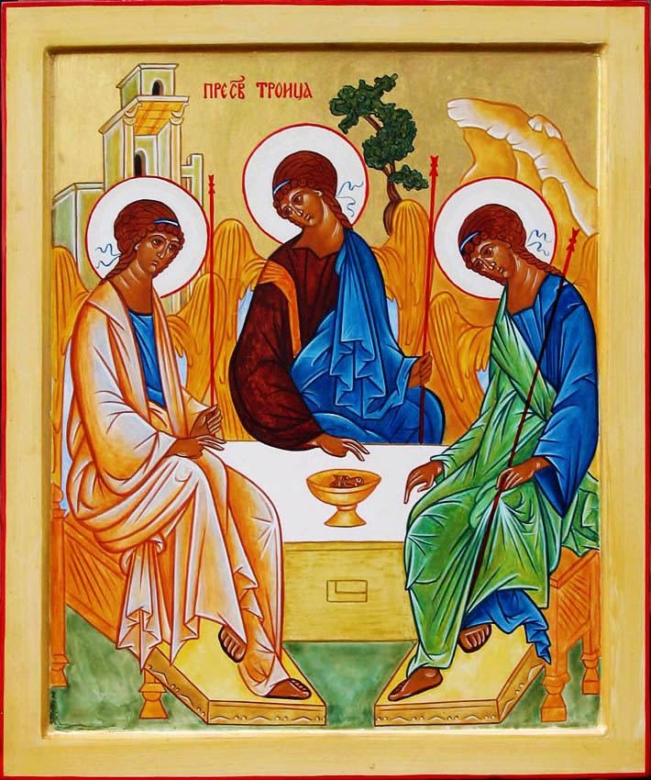
6.Rublev’s famous Icon of the Trinity
Notes:
7am - 14th Sunday in Ord Time
7am - 14th Sunday in Ord Time

Slide 8
It has inspired many to recognise the inner union and movement of love between Father, Son and Holy Spirit.
Notes:
7am - 14th Sunday in Ord Time
7am - 14th Sunday in Ord Time

Slide 9
Do you notice a gap at the table ready for you to pull up a chair? What do you think this means?
Notes:
7am - 14th Sunday in Ord Time
7am - 14th Sunday in Ord Time

Slide 10
One interpretation is this is the invitation at the Eucharist to join in becoming one with God in Holy Communion.
Notes:
7am - 14th Sunday in Ord Time
7am - 14th Sunday in Ord Time

Slide 11
Please Stand

Slide 12
This slide is hidden.
Insert the Entrance Hymn after this slide

Slide 13
Holy God we praise thy name
Holy God, we praise thy name;
Lord of all, we bow before thee;
all on earth thy scepter claim;
all in heaven above adore thee.
Infinite thy vast domain;
everlasting is thy reign.

Slide 14
Holy Father, Holy Son,
Holy Spirit: three we name thee,
though in essence only one;
undivided God we claim thee,
and adoring bend the knee
while we own the mystery.

Slide 16
Confiteor
I confess to almighty God
And to you, my brothers and sisters,
That I have greatly sinned
In my thoughts and in my words

Slide 17
In what I have done
And in what I have failed to do,
Through my fault,
Through my fault,
Through my most grievous fault;

Slide 18
Therefore I ask blessed Mary ever-Virgin,
All the Angels and Saints,
And you, my brothers and sisters,
To pray for me to the Lord our God.

Slide 20
Kyrie eleison
Kyrie eleison (2)
Christe eleison (2)
Kyrie eleison (2)

Slide 22
Gloria
Glory to God in the highest,
and on earth peace to people of good will.
We praise you, we bless you,
we adore you, we glorify you,

Slide 23
We give you thanks for your great glory,
Lord, God heavenly king,
O God, almighty father

Slide 24
Glory to God in the highest,
and on earth peace to people of good will.

Slide 25
Lord Jesus Christ, Only Begotten Son,
Lord God, Lamb of God, Son of the Father,
you take away the sins of the world,
have mercy on us;

Slide 26
you take away the sins of the world, receive our prayer;
you are seated at the right hand of the Father,
have mercy on us.

Slide 27
Glory to God in the highest,
and on earth peace to people of good will.

Slide 28
For you alone are the Holy One,
you alone are the Lord,
you alone are the Most High, Jesus Christ,
with the Holy Spirit,
in the glory of God the Father.

Slide 29
Glory to God in the highest,
and on earth peace to people of good will.
Amen.

Slide 31
Responsorial Psalm
Glory and praise forever!

Slide 33
Alleluia
Alleluia, alleluia,
alleluia, alleluia

Slide 35


Slide 36
YOUTUBE

Slide 37


Slide 38
Apostles Creed
I believe in God,
the Father almighty,
Creator of heaven and earth,
and in Jesus Christ, his only Son, our Lord,
(At the words that follow, up to and including the Virgin Mary, all bow.)

Slide 39
who was conceived by the Holy Spirit,
born of the Virgin Mary,
suffered under Pontius Pilate,
was crucified, died and was buried;
he descended into hell;

Slide 40
on the third day he rose again from the dead;
he ascended into heaven,
and is seated at the right hand of God the Father almighty;

Slide 41
from there he will come to judge the living and the dead.
I believe in the Holy Spirit,
the holy catholic Church,

Slide 42
the communion of saints,
the forgiveness of sins,
the resurrection of the body,
and life everlasting.
Amen.

Slide 44
First Collection
This collection goes to the Bishop
for the support of the Diocese.
Thank you for your contribution

Slide 46
This slide is hidden.
Insert the Offertory Hymn after this slide.

Slide 47
Lord take control of me
Lord take control of me
Renew my mind and help me see
That the fullness of your life and love
Are mine to share

Slide 48
Make me a channel of
Your saving grace and cleansing blood
Make my life a shelter for
Our brother in despair

Slide 49
Release me now
Into the current of your spirits power
And fill me lord each moment
Of the day and every hour

Slide 50
Make my life count for you
In everything I say and do
Help me ever to pursue
The fullness of your love

Slide 51
Lord take complete control
Of my body, mind and soul
Give me grace to trust you
And surrender to your will

Slide 52
Let me know your promised rest
When I face each trial and test
So that you may manifest
Yourself to all the world

Slide 53
Release me now
Into the current of your spirits power
And fill me lord each moment
Of the day and every hour

Slide 54
Make my life count for you
In everything I say and do
Help me ever to pursue
The fullness of your love

Slide 55
Take my life Lord fill it with your love

Slide 57
Priest: Pray my brothers and sisters,
that my sacrifice and yours may be
acceptable to God, the almighty Father.
All: May the Lord accept the sacrifice
at your hands for the praise and glory of his name, for our good and the good of all his holy Church.

Slide 58
Priest: The Lord be with you.
All: And with your spirit.
Priest: Lift up your hearts.
All: We lift them up to the Lord.

Slide 59
Priest: Let us give thanks to the
Lord our God.
All: It is right and just.

Slide 61
Holy
Holy, Holy, Holy Lord God of hosts,
Heaven and earth are full of your glory. Hosanna in the highest
Blessed is he who comes
in the name of Lord,
Hosanna in the highest.

Slide 63
Memorial acclamation
Save us saviour of the world,
For by your cross and resurrection,
You have set us free

Slide 64
Memorial acclamation
When we eat this bread
And drink this cup
We proclaim your death O Lord
Until you come again

Slide 65
Memorial acclamation
We proclaim your death O Lord
And profess your resurrection
Until you come again

Slide 67
Amen
Amen, amen, amen, amen.
Amen, amen, amen, amen.

Slide 69
Priest: The Lord be with you.
All: And with your spirit

Slide 71
Peace
May the peace of the Lord be with you
With your friends and your family too
Let it be, let it grow
And everywhere you go
May the peace of the Lord follow you

Slide 72
Lamb of God
Lamb of God, lamb of God
You take away the sins of the world
Have mercy on us, lamb of God

Slide 73
Lamb of God, lamb of God
You take away the sins of the world
Have mercy on us, lamb of God

Slide 74
Lamb of God, lamb of God
You take away the sins of the world
Grant us, grant us peace

Slide 76
All: Lord, I am not worthy
that you should enter under my roof,
but only say the word
and my soul shall be healed.

Slide 78
Priest: Behold the Lamb of God, behold him
who takes away the sins of the world.
Blessed are those called to the supper of the Lamb.
All: Lord, I am not worthy
that you should enter under my roof,
but only say the word
and my soul shall be healed.

Slide 79
This slide is hidden.
Insert the Communion Hymns after this slide.

Slide 80
Jesus my Lord my God my all
Jesus, my Lord, my God, my all!
How can I love Thee as I ought?
And how revere this wondrous gift,
So far surpassing hope or thought?

Slide 81
Sweet Sacrament, we Thee adore!
Oh, make us love Thee more and more.
Oh, make us love Thee more and more.

Slide 82
Had I but Mary's sinless heart
With which to love Thee, dearest King,
Oh, with what ever fervent praise,
Thy goodness, Jesus, would I sing!

Slide 83
Sweet Sacrament, we Thee adore!
Oh, make us love Thee more and more.
Oh, make us love Thee more and more.

Slide 84
Thy Body, Soul and Godhead, all!
O mystery of love divine!
I cannot compass all I have,
For all Thou hast and art is mine!

Slide 85
Sweet Sacrament, we Thee adore!
Oh, make us love Thee more and more.
Oh, make us love Thee more and more.

Slide 86
Sound, then, His praises higher still,
And come, ye angels, to our aid;
For this is God, the very God
Who hath both men and angels made!

Slide 87
Sweet Sacrament, we Thee adore!
Oh, make us love Thee more and more.
Oh, make us love Thee more and more.

Slide 88
That the world may know
Father we thank you for the truth
We have in Jesus,
And for the message
He has given us to share.

Slide 89
We know that only through His name
We have admittance
To boldly come before Your throne
In fervent prayer

Slide 90
We thank you for the wondrous gift
Of or salvation
And for the life
That we are sharing form above.

Slide 91
Now glorify!
The one who dwells within us,
So that the world may know
Of Jesus and his love.

Slide 92
The Saviour into the world
to reap the harvest
That others too may know
the glory of your Son

Slide 93
Give us the strength that comes
From trusting in our spirit
That we might work and see
the great commission done

Slide 94
We thank you for the unity
we have in Jesus
That in his spirit together
we are one

Slide 95
Now glorify!
The one who dwells within us,
So that the world may know
Of Jesus and his love.

Slide 97
Second Collection
What you contribute now
is for the support of our
parish and its mission.
Thank you for your generosity

Slide 98
This slide is hidden.
Insert the Notices for the week after this slide

Slide 99

SVDP PANTRY
Sugar
Baked Beans
Pasta Sauce
Tinned Fruit
Tinned Meat (corned beef, leg ham)
Thank you for your generosity!

Slide 100
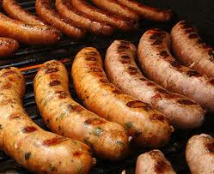
Vinnies Winter Appeal
Thank you for your support of Vinnies Winter Appeal
BBQ after 8.00am
and 9.30am Mass

Slide 101
St Vincent De Paul
Are you interested in the works of
St Vincent de Paul Conference…
Assist-A-Student
Speak to a conference member today in the Piety stall or write your name on the sheets …

Slide 102
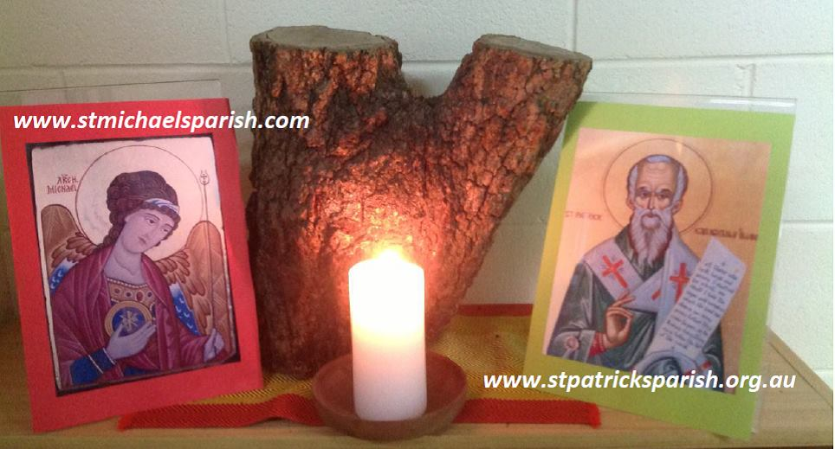
Please take home your bulletin or download it
www.stmichaelsparish.com
Visit us on Facebook
www.facebook.com/blacktowncatholics

Slide 103
This slide is hidden.
The next slide can be used for videos.
Insert the video into the slide.

Slide 105
Priest: The Lord be with you.
All: And with your spirit.

Slide 107
This slide is hidden.
Insert the Recessional Hymns after this slide.

Slide 108
How great thou art
O Lord my God,
When I in awesome wonder,
Consider all the worlds
Thy Hands have made;

Slide 109
I see the stars,
I hear the rolling thunder,
Thy power throughout
the universe displayed.

Slide 110
Then sings my soul,
My Saviour God, to Thee,
How great Thou art,
How great Thou art.

Slide 111
Then sings my soul,
My Saviour God, to Thee,
How great Thou art,
How great Thou art.

Slide 112
When through the woods,
and forest glades I wander,
And hear the birds
Sing sweetly in the trees.

Slide 113
When I look down,
from lofty mountain grandeur
And see the brook,
and feel the gentle breeze.

Slide 114
Then sings my soul,
My Saviour God, to Thee,
How great Thou art,
How great Thou art.

Slide 115
Then sings my soul,
My Saviour God, to Thee,
How great Thou art,
How great Thou art.

Slide 117
This slide is hidden.
Insert the final slide here.

